Slide 1


Kinetic Monte Carlo study of TDDB in STTMRAM MgO

Slide 2
Agenda
Device
Literature
Hypothesized models and assumptions
Objectives of Atomistic simulation
Contribution and Novelty
Kinetic Monte Carlo Simulation and Equations
KMC discussion on 31 Jan 22
Potentially add TEM data from GF

Slide 3
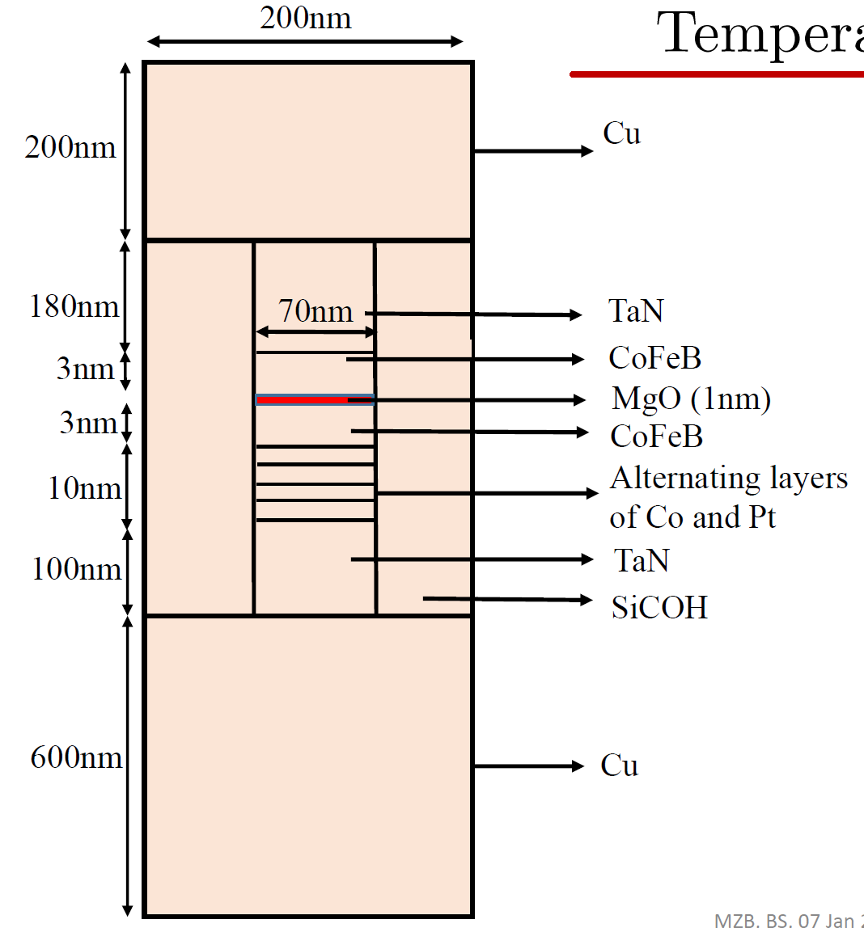
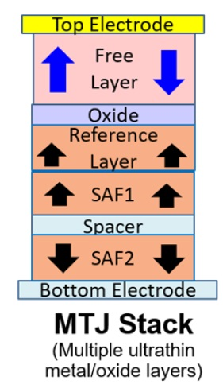
Device
Study the breakdown of this
Voltages used 0.7-0.9V

Slide 4
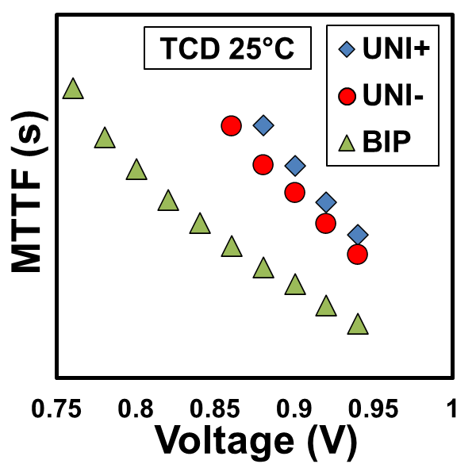
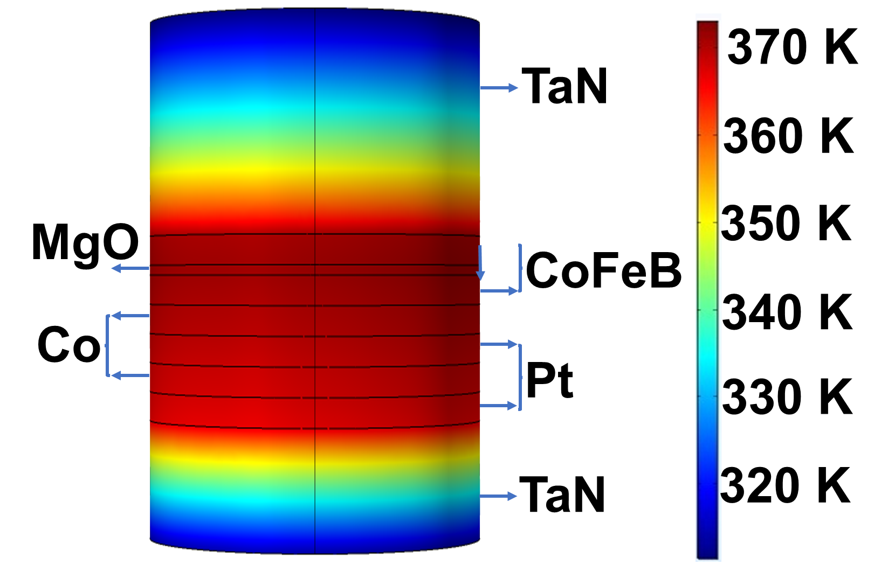
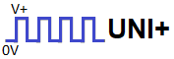
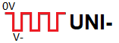
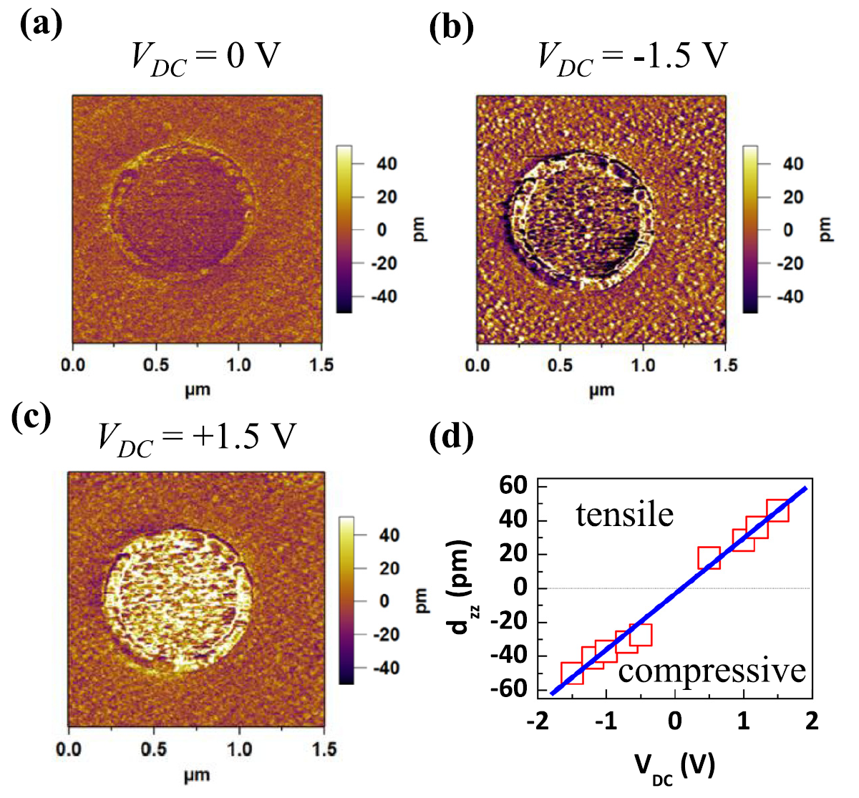
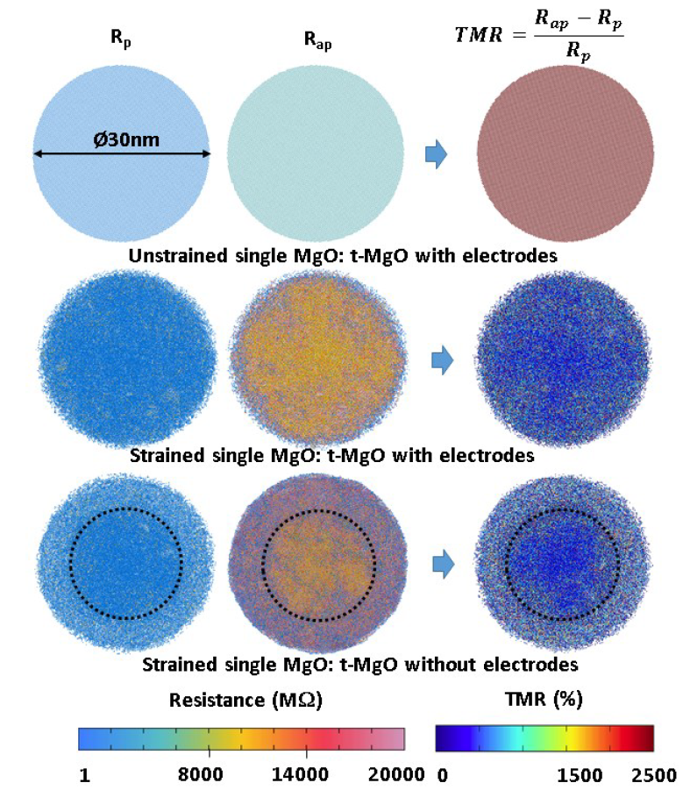
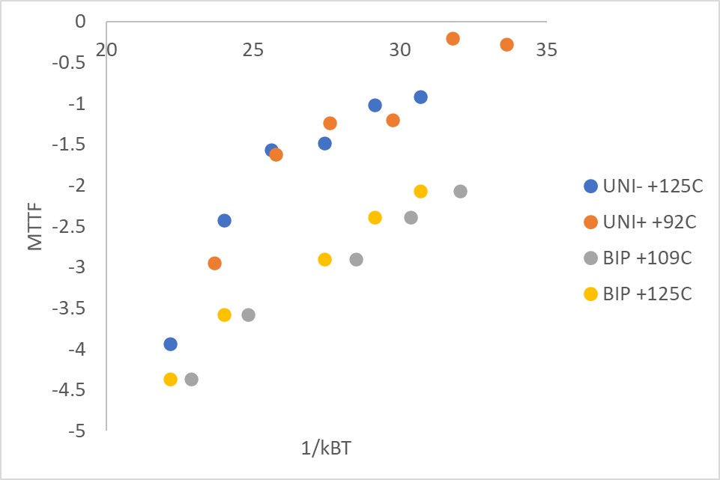
Literature
UNI vs BIP pulsing MTTF
Self-heating
Strain effects
V+
0V
V-
BIP
Mean-time-to-failure BIP<<UNI
Why BIP is not avg(UNI- and UNI+)?
Simulation of Self-heating in the MgO
Main difference in UNI+ and UNI- MTTF could be accounted for with SH.
BIP still very different.
Piezoelectric effect causing strain fatigue
Strain causes uneven resistance and other effects (simulation)
2014 Naik et al. Effect of electric-field on the perpendicular magnetic anisotropy and strain properties in CoFeB/MgO magnetic tunnel junctions
2018 Sankaran et al. Evidence of Magnetostrictive Effects on STT-MRAM Performance by Atomistic and Spin Modeling

Slide 5
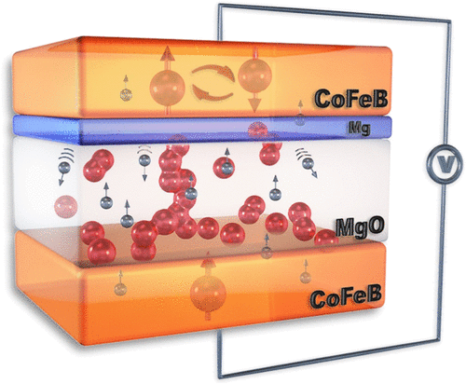
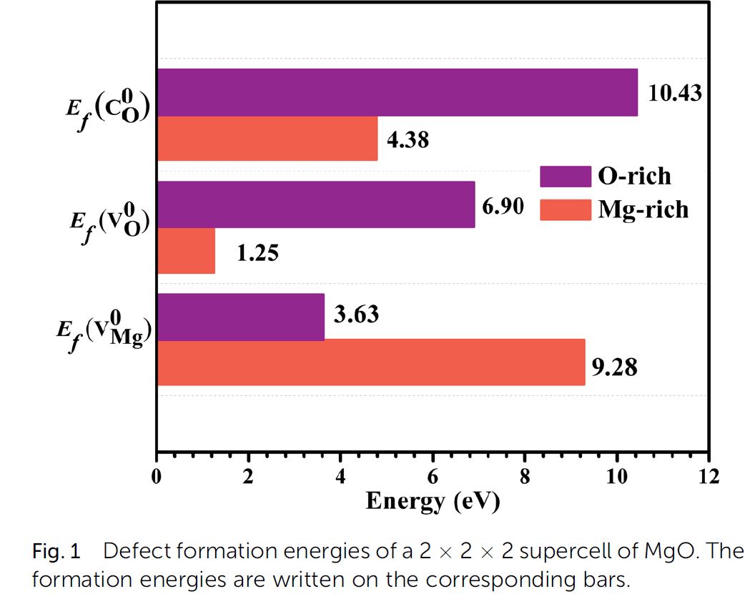
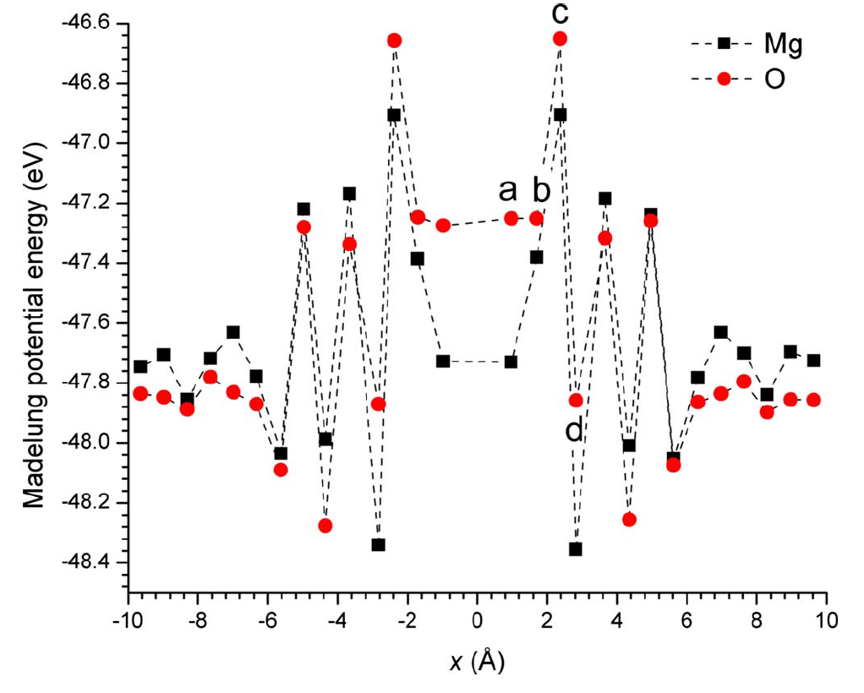
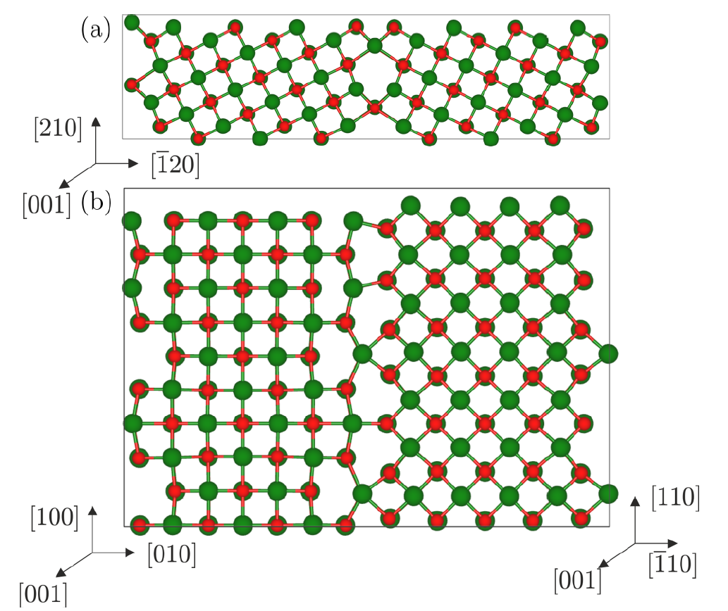
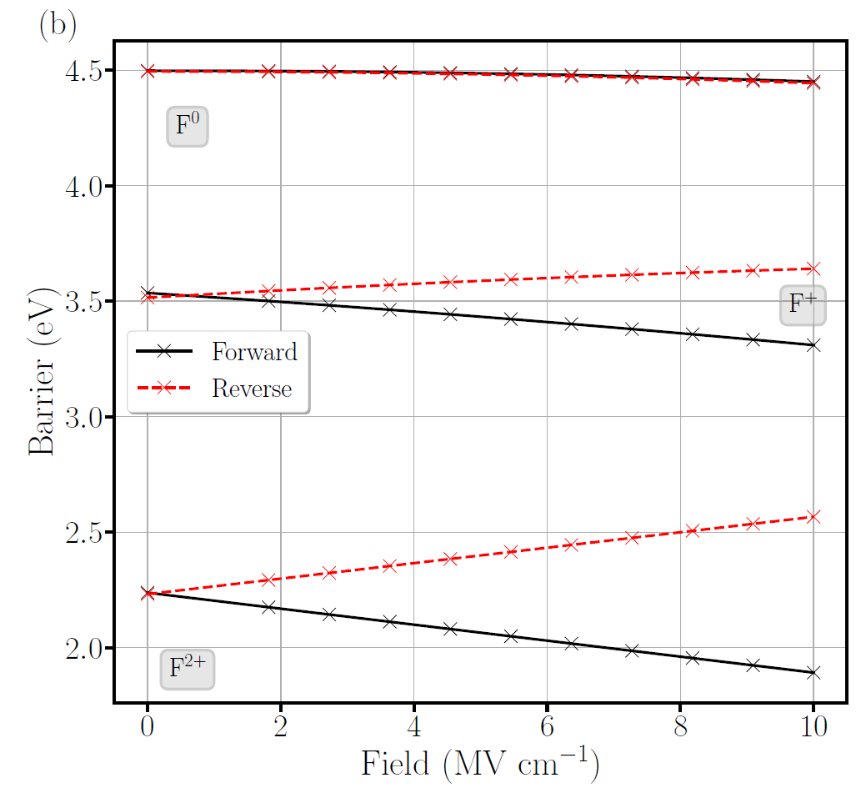
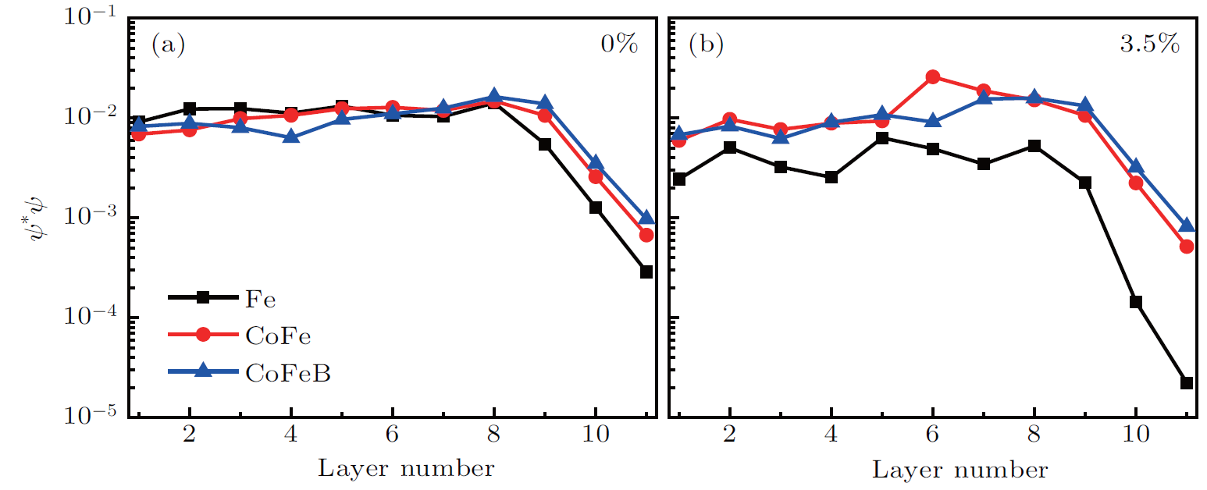
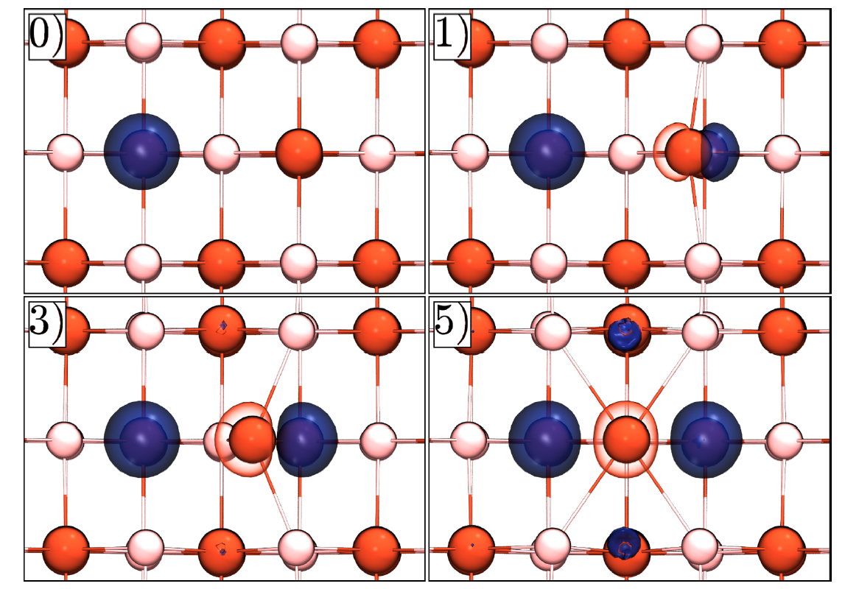
Literature
4. Defect DFT studies
Mg insertion layer between MgO-CoFeb interface changing crystallinity and defect formation. Improved TDDB but worsened magnetism.
Ramesh et al. 2021 Insertion Trade-off Effects on the Spin-Transfer Torque Memory Explored by In Situ X-ray
Fang-Guang Kuang et al. 2017 An ab initio study on the electronic and magnetic properties of MgO with intrinsic defects
McKenna et al. 2009 First-principles calculations of defects near a grain boundary in MgO
Bean et al. 2018 Stability of point defects near MgO grain boundaries in FeCoB/MgO/FeCoB magnetic tunnel junctions
Majority Δ₁ Spin Bloch State
0% strain
3.5% strain
Fei Guo et al. 2018 Strong anti-strain capacity of CoFeB/MgO interface on electronic
structure and state coupling
(a) Change in electron density of the F0 center along its migration pathway. The red and light pink spheres are O and Mg, respectively (b)Values of the migration barriers of F centers in MgO as an electric field is applied.
El-Sayed et al. 2018 Effect of electric field on migration of defects in oxides: Vacancies and interstitials in bulk MgO

Slide 6
Literature Review
Mahmoud et al., CNRS, 2021, Diffusion mechanism of bound Schottky defect in magnesium oxide
El-Sayed et al. 2018 Effect of electric field on migration of defects in oxides: Vacancies and interstitials in bulk MgO
Carboni et al. 2018 Modeling of Breakdown-Limited Endurance in Spin-Transfer Torque Magnetic Memory Under Pulsed Cycling Regime

Slide 7
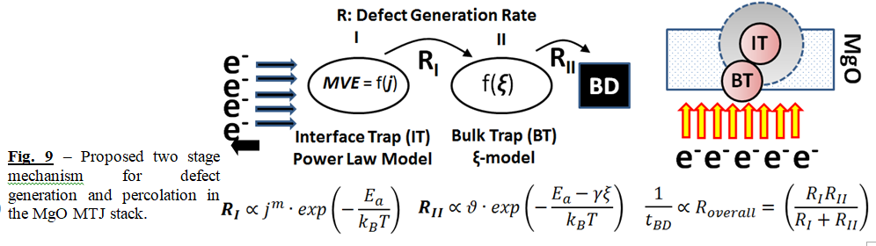
Model 1: Combined two-step breakdown model
*Supplementary info in appendix
CoFeB
e⁻
e⁻
e⁻
e⁻
CoFeB
UNI mode
U1. Interface defects (ID) form.
U2. IDs reduce activation energy for bulk defect (BD) U3. BD triggers the final defect at other interface.
e⁻
e⁻
e⁻
e⁻
BIP mode
B1ab. IDs form, accelerated by strain fatigue.
B2. IDs at both side drastically reduce activation energy for BD. Hence, MTTF for BIP << UNI+/-.
UNI+
U3
BIP
B1a
U2
B2
MgO
U1
MgO
B1b
CoFeB
CoFeB
e⁻
e⁻
e⁻
e⁻

Slide 8
Model 2: UNI TDDB mechanism (Release-Reaction model)
*Supplementary info in appendix
CoFeB
(+) anode
: O vacancy or Boron
To do:
Current density plots with SH correction
Still unsure:
Single or multi domain crystal
1. Release of Defect
MgO
2. Diffusion of Defect
3-4 monolayers
3. Reaction of Defect
CoFeB (-) cathode

Slide 9
Model 2: BIP TDDB mechanism
O
M
O
*Supplementary info in appendix
M
M
O
M
O
O
M
M
O
Supporting info:
According to Macpherson's paper, the effects of external field scale to the equation (2+k)/3 (valid for cubic and amorphous dielectrics), where k is dipole moment. That means MgO has 9/5 to 12/5 times more field effect than SiO2. The effective field in the MgO is 16-20MV/cm.
Check if MgO is Ferroelectric?
Look at how piezoelectrics fail for mechanical failure.
Check Crystallization/Annealing temperature of MgO. Can we use TMR to gauge crystallinity in MgO.
Check d_{zz} meaning with Naik.
Explore Asymmetric BIP DOE before send out!!!
CoFeB
1. UNI+, defect displaces up
MgO
2. UNI-, defect displaces up
Possible experiments to rule out model:
Asymmetric BIP will lead to net diffusion.
Varying PW, might get to PW>diffusion time constant. If PW long enough, defect can diffuse over in one PW. Caution: if PW too long, might hit V_{BD}.
Check if compressive + tensile strains can account for order of magnitude decrease in MTFF. Can we think of it as a spring? Check flexible electronics.
Resultant zero net displacement
CoFeB
: O vacancy or B

Slide 10
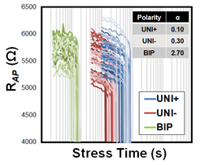
Model 2: Why BIP is still power law
CoFeB
CoFeB
CoFeB
CoFeB
MgO
MgO
MgO
MgO
One PW
Random walk
CoFeB
CoFeB
CoFeB
CoFeB
: O vacancy or B
: O vacancy or B
: O vacancy or B
: O vacancy or B
1. At initial time, there are a few defects in MgO.
2. Defects are generated overtime, but most have zero net-displacement. This lowers the resistance of the oxide due to trap-assisted tunneling.
3. At a threshold concentration of defects, some defects make it to the interface via random walk or in one PW. This weakens the oxide and lowers resistance.
4. The falling resistance leads to higher current, and more defects make it across. A positive feedback loop that leads to more abrupt failure.

Slide 11
Possible objectives for Atomistic simulation
Does the presence of an oxygen vacancy in MgO make it easier for another defect to be created in the vicinity? If so, by how much could the activation energy reduce?
How does interfacial strain (tensile / compressive) affect the activation energy needed for Mg-O bond breaking?
How much lower could the activation energy for Mg-O bond breaking be at a grain boundary site as compared to a bulk grain site?
How does MgO bond energy-level excite with temperature? (refer to Fig 5. Wu et al. 2013 Generalized hydrogen release-reaction model for the breakdown of modern gate dielectrics)
Are the defects Boron-based interstitials or Oxygen vacancies? We suspect that O vac. are more likely. Stack is likely to be under-oxidized, so likely to have some O-vac at initial state.
Are defects more likely to spread via Model 1 Adjacent defect induced formation or Model 2 diffusion/drift?

Slide 12
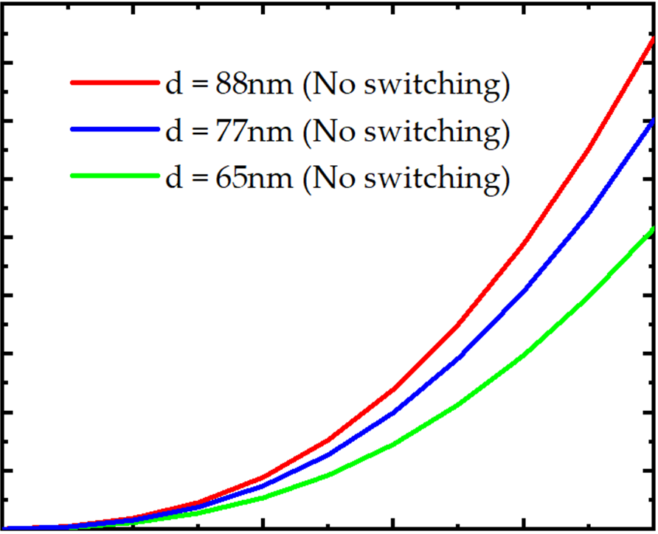
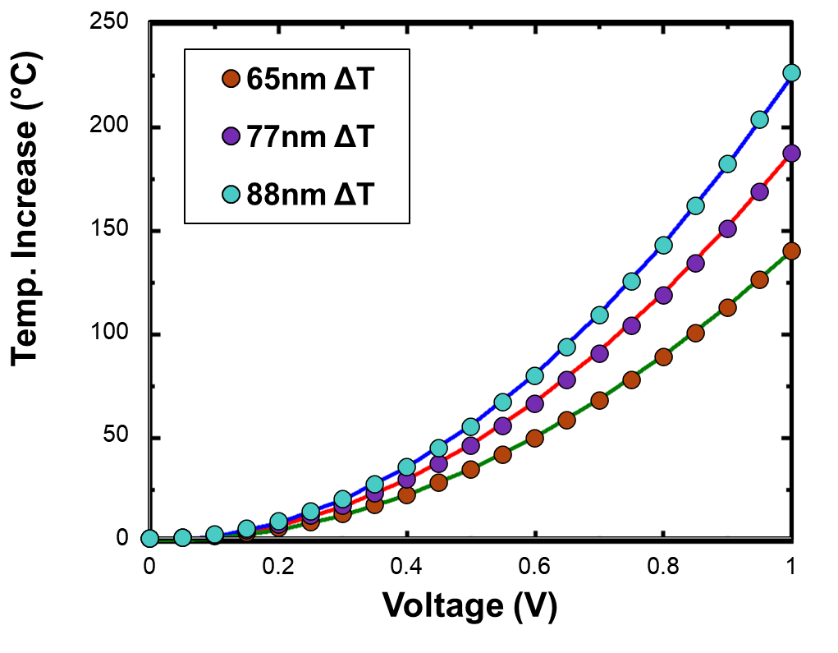
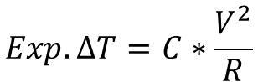
What we know
Dots are expt
Line is sim
Dots are expt
Line is sim
UNI+ AP state
UNI- P state
$$Exp.∆T=C∗\frac{V^{2}}{R}$$
Experimental ΔT_{SH} increase fits well with Zunaid’s simulation
C is obtained by manual tweaking to fit Zunaid’s curve. This is still non-trivial as R decreases with V (especially R_{AP}) so not expected to fit perfectly.
C is uniform for a given CD and T_{ambient}.
PW is tricky to simulate. C should be uniform for given PW. Naga has suggested simulating ΔT_{SH} vs. PW, still thinking about it. Zunaid has simulated with a different/normalized PW that produces comparable ΔT_{SH}. I’m not sure of details.
 | P | AP
65 | 0.43 | 0.69
77 | 0.41 | 0.54
88 | 0.38 | 0.54
Table 1. C vs CD and Polarity

Slide 13
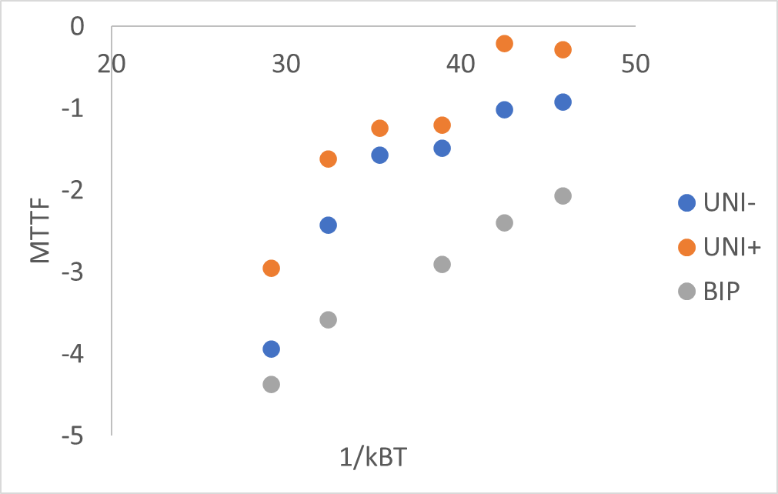
What we know
Main difference in UNI+ and UNI- MTTF could be accounted for with SH.
BIP still very different.
MTTF trend seems non-Arrhenius… more on that later
Before UNI- SH correction
After SH correction
*key plots
Unsure BIP SH correction due to switching.
+109C is from averaging ΔT_{SH} of UNI- and UNI+.
+125C is from worst case (ie. P state).
Note: PW=200ns throughout this presentation!

Slide 14
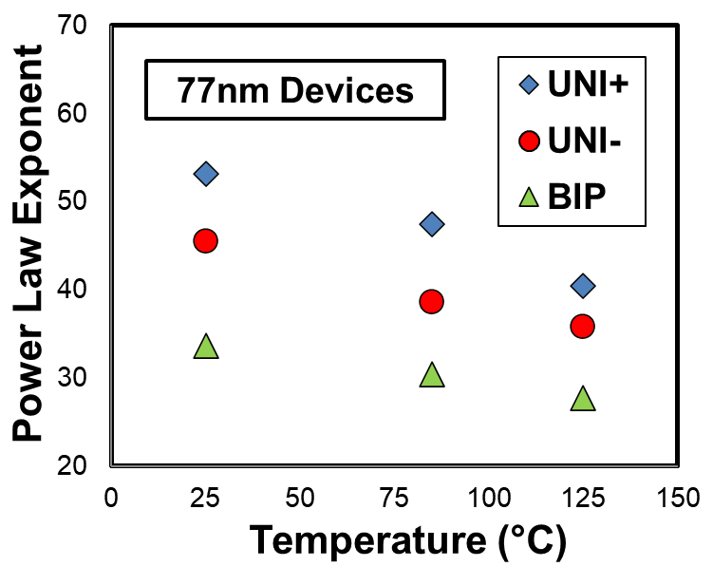
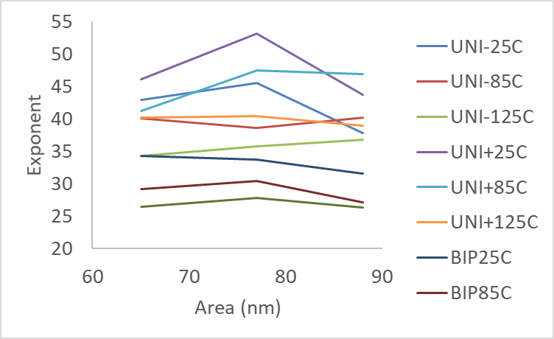
What we know
Power Law Exponent decreases with temperature
Power Law Exponent no specific trend with device area
(How power law comes about→) FIG. 5. Schematics of the thermally assisted hydrogen release model. When Si-H bond is in the ground state at T¼0 C (a), Si-H breakage occurs through excitation over all the energy-levels by electrons. When Si-H bond is excited to higher energy states at finite temperatures (b), the number of energy levels for bond breakage are reduced, leading to smaller exponents since the power-law exponents is equal to 4N.9–12 This new model explains the reduction of the power law exponent with increasing temperature.

Slide 15
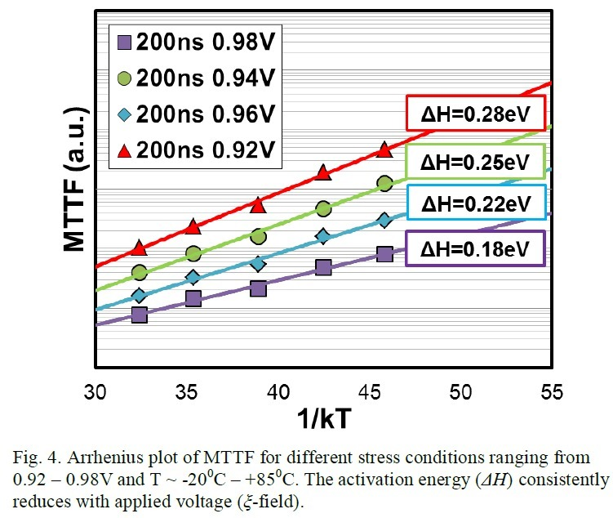
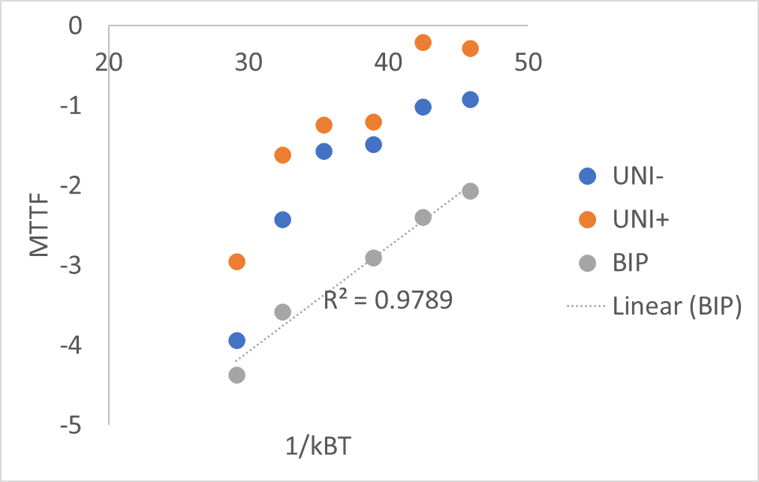
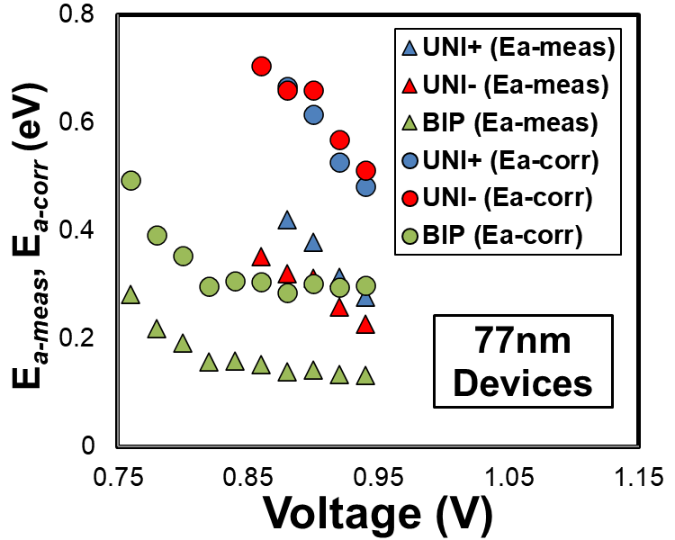
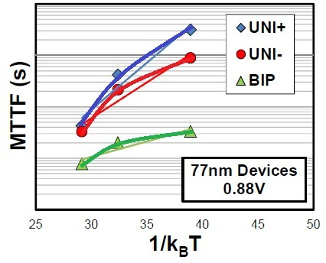
Open question 1: Arrhenius or not?
YES
NO: trend is non-linear for UNI. -20 to 125C
Trend is linear FOR BIP in previous paper by Jiahao “Correct Extrapolation…” for -20 to 85C
Ea range = 0.18-0.28eV
0.92-0.98V
*Lines are visual aids
UNI+ and UNI- Ea matches after SH correction
Ea range = 0.17-0.19eV
0.92-0.98V

Slide 16
Open question 1: Arrhenius or not?
In Wu et al. 2012 “Temperature Dependence of TDDB Voltage Acceleration in High-κ/ SiO2Bilayers and SiO2 Gate Dielectrics” talks about non-Arrhenius trends in HfO2 stacks. The paper DOES NOT have a single plot of Ea - versus - voltage or field because extracting E_{a} makes no sense.
Wu et al. 2013 “Generalized hydrogen release-reaction model for the breakdown of modern gate dielectrics” clearly claims that to PROVE that field and current both play a role in the BD process, we should be observing non-Arrhenius trends.

Slide 17
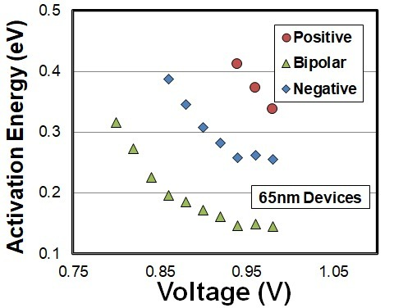
Open question 2: Two E_{a} regimes
*Assuming Arrhenius is true.
We observe two Ea regimes that are unexplained. (Could be due to mechanical causes)
To remove UNI cases. Can plot in MV/cm units instead.
Gradient = dipole moment*permittivity. Gradient has a physical meaning. Suspect dipole moment.
Left plot is with Jiahao’s SH correction which assumes ΔT_{SH} is uniform for all ambient temperatures.
*Lines are visual aids
*Lines are visual aids
*key plot
Blue and green lines seem parallel

Slide 18
Group Meeting
An ab initio study on the formation energy (E_{f}) of MgO
Reporter：Tong Su
Supervisor：Prof Ang Yee Sin
Date：06/12/2021

Slide 19
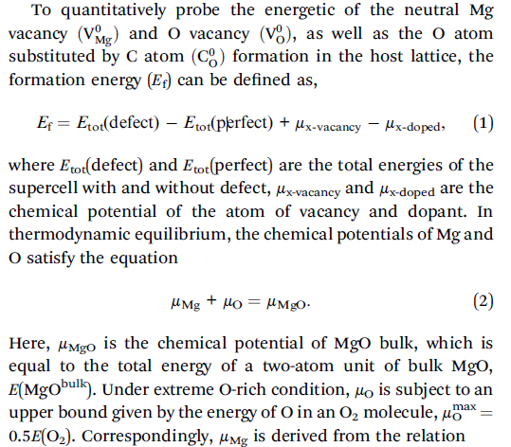
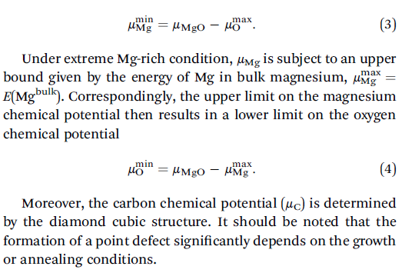
Calculation theory
Fang-Guang Kuang et al. 2017 An ab initio study on the electronic and magnetic properties of Mg0 with intrinsic defects

Slide 20
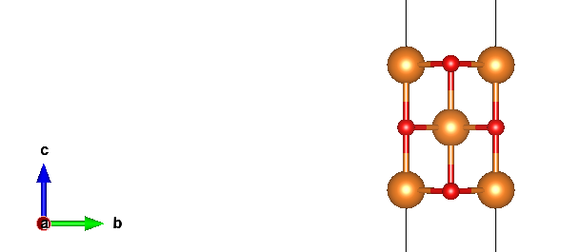
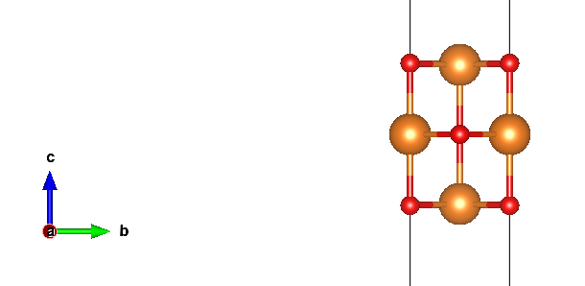
3-layer test
Toten Energy=-34.71809618 eV
4.19793(0) Å
Toten Energy=-34.71809618 eV eV
4.29596(0) Å

Slide 21
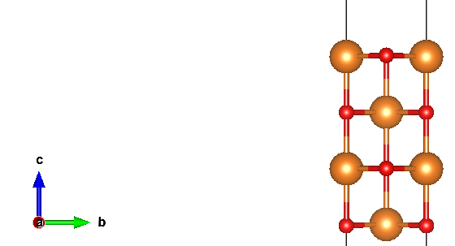
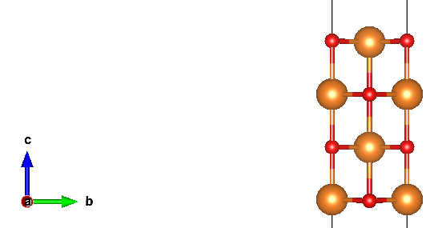
4-layer test
Toten Energy=-46.63555909 eV
6.36825(0) Å
Toten Energy=-46.63555909 eV
6.36825(0) Å

Slide 22
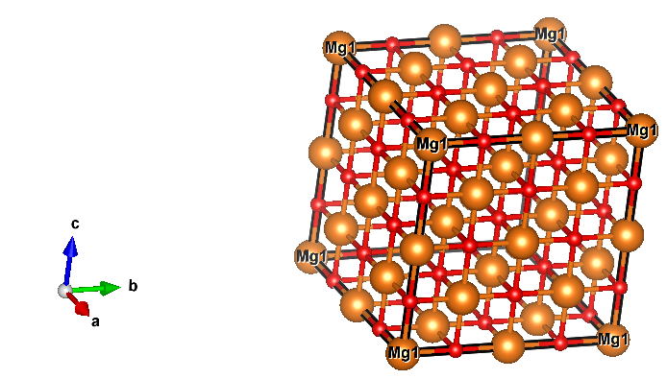
2X2X2 supercell bulk MgO (cubic)
O

Slide 23
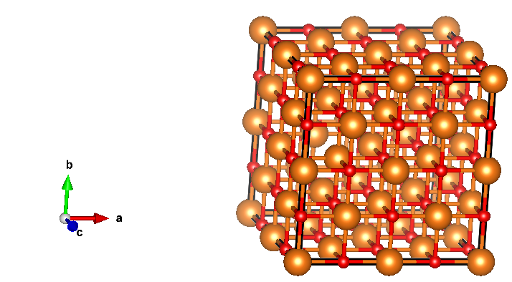
O vacancy in 2X2X2 supercell MgO (cubic)
O-rich:
Ef=6.712164 eV
Mg-rich:
Ef=1.208855 eV
O-vacancy

Slide 24
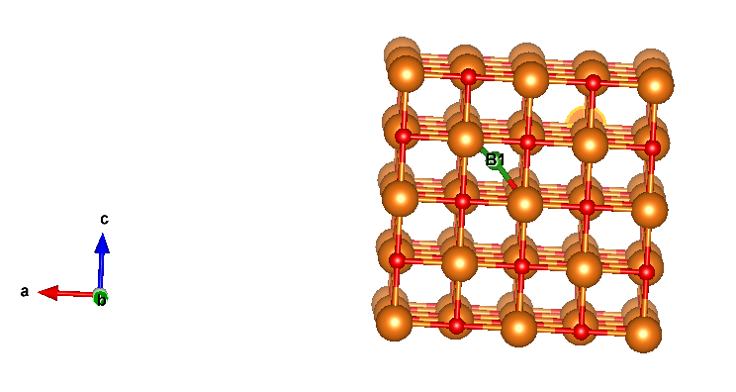
B doping in 2X2X2 supercell MgO (cubic)
O-rich:
Ef=8.117685 eV
Mg-rich:
Ef=8.117685 eV

Slide 25
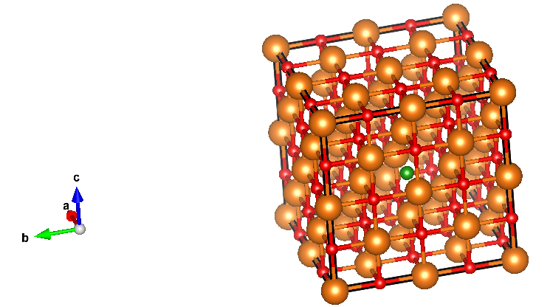
B substitute O in 2X2X2 supercell MgO (cubic)
O-rich:
Ef=12.09441 eV
Mg-rich:
Ef=5.152813 eV
B substituent O

Slide 26
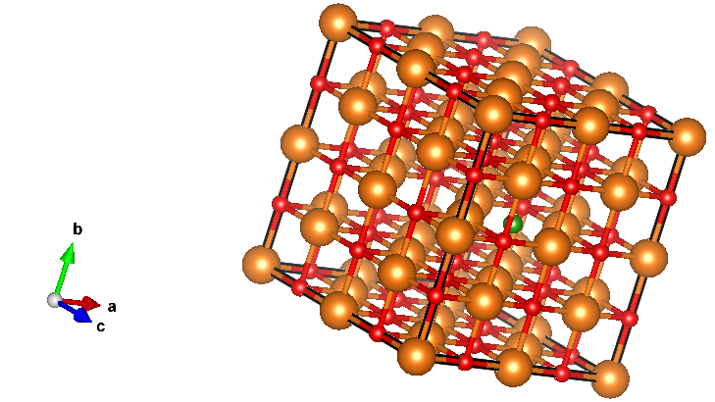
B substitute O nearby O vacancy in 2X2X2 supercell MgO (cubic)
O-rich:
Ef=17.68484 eV
Mg-rich:
Ef=6.678223 eV
O-vacancy
B substitute O

Slide 27
Calculation original data
 |  | O-rich(Ef) | Mg-rich(Ef)
2X2X2MgO(bulk) | -381.3264188
O-defect | -369.666255 | 6.71216383 | 1.20885536
B doping | -379.8881335 | 8.11768531 | 8.11768531
O-B doping | -370.9634125 | 12.09440633 | 5.15281255
2O-B doping | -360.4249784 | 17.68484044 | 6.6782235
bulk MgO | -11.9140852
cubic bulk Mg | -1.46277673
μ(O) | -4.948
μ(B) | -6.6794

Slide 28
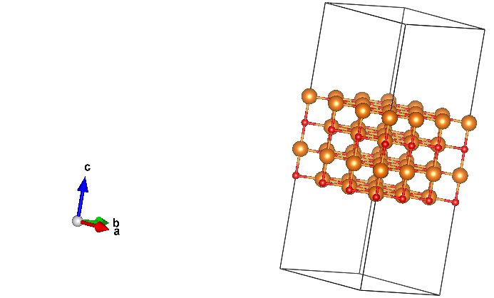
3X3X1 supercell MgO (cubic)

Slide 29
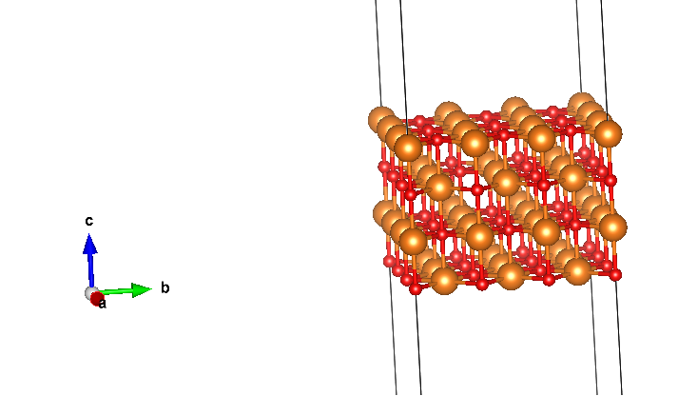
O vacancy in 3X3X1 supercell MgO (cubic)
O-rich(Ef) | Mg-rich(Ef)
6.57355848 | 1.07025001

Slide 30
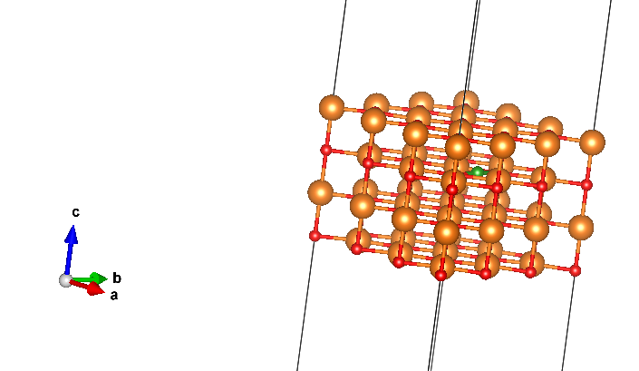
B doping in 3X3X1 supercell MgO (cubic)
O-rich(Ef) | Mg-rich(Ef)
5.54999535 | 5.54999535

Slide 31
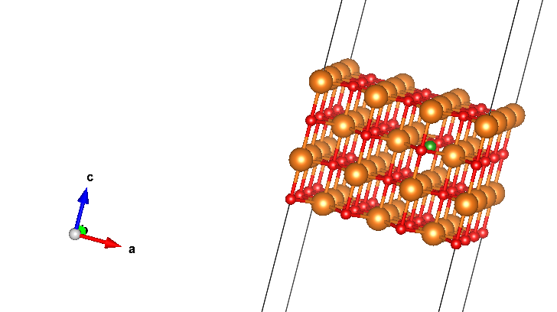
B substitute O in 3X3X1 supercell MgO (cubic)
O-rich(Ef) | Mg-rich(Ef)
11.66579919 | 6.16249072

Slide 32
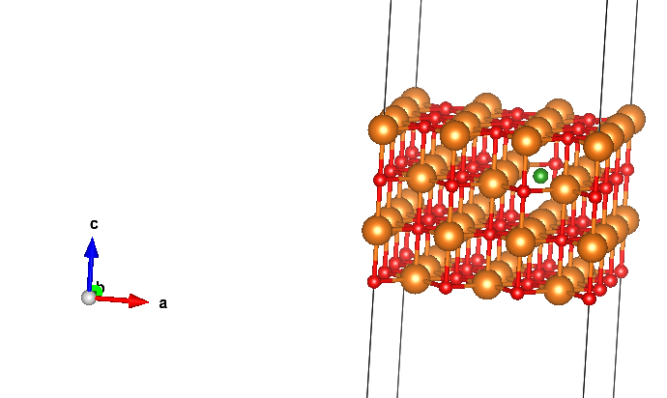
B substitute O nearby O vacancy in 3X3X1 supercell MgO (cubic)
O-rich(Ef) | Mg-rich(Ef)
17.10775361 | 6.10113667

Slide 33
 |  | O-rich(Ef) | Mg-rich(Ef)
3X3X1MgO(4-layer) | -419.7621278
O-defect | -408.2405693 | 6.57355848 | 1.07025001
B doping | -420.8915324 | 5.54999535 | 5.54999535
O-B doping | -409.8277286 | 11.66579919 | 6.16249072
2O-B doping | -399.4377741 | 17.10775361 | 6.10113667
bulk MgO | -11.9140852
cubic bulk Mg | -1.46277673
μ(O) | -4.948
μ(B) | -6.6794

Slide 34
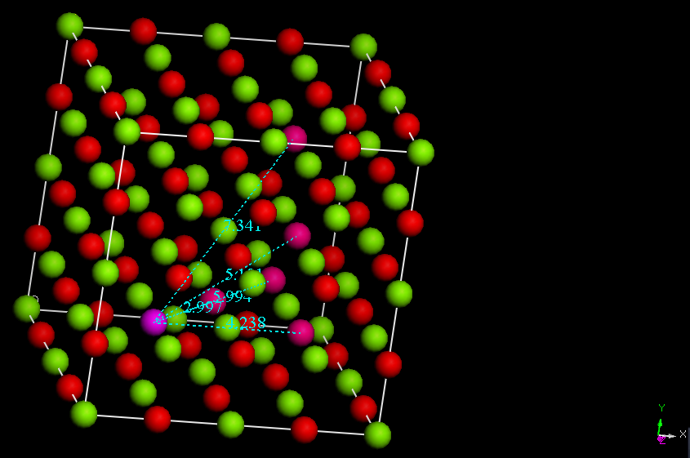

Slide 35
O-O vacancies distance |  |  | O-rich(Ef)(eV) | Mg-rich(Ef)(eV)
2.997Å | 2O vacancies（1） | -358.0973867 | 13.3330321 | 2.32641516
4.238Å | 2O vacancies（2） | -357.9818072 | 13.44861162 | 2.44199468
5.994Å | 2O vacancies（3） | -357.9980506 | 13.43236824 | 2.4257513
5.191Å | 2O vacancies（4） | -357.9869458 | 13.44347304 | 2.4368561
7.341Å | 2O vacancies（5） | -357.9976899 | 13.43272894 | 2.426112

Slide 36
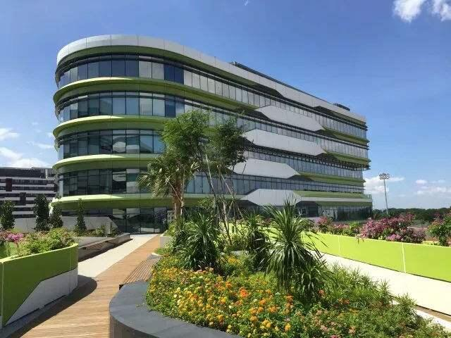
Thank YOU！

Slide 37
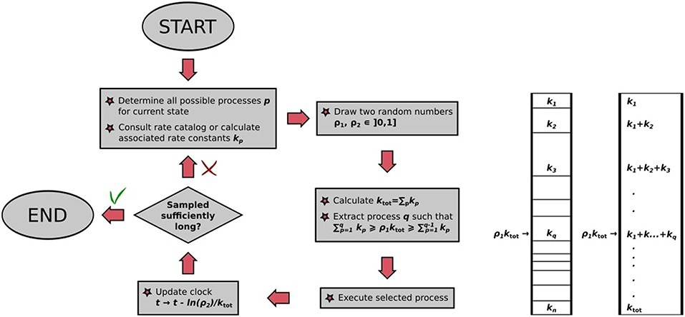
Kinetic Monte Carlos Algorithm
M. Andersen et al. Front. Chem. 2019 A Practical Guide to Surface Kinetic Monte Carlo Simulations

Slide 38
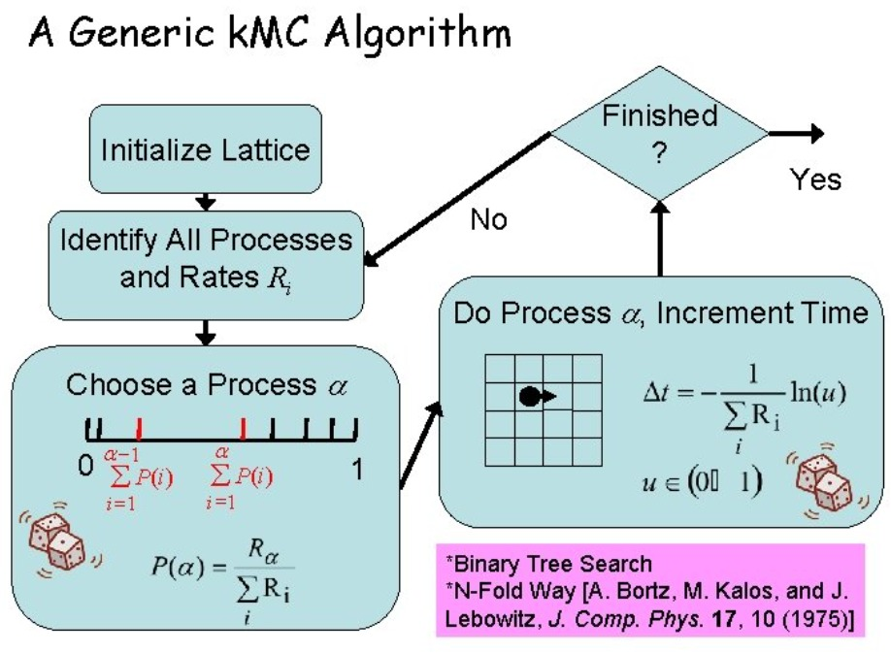
Kristen A. Fichtorn Kinetic Monte Carlo Simulations and Applications

Slide 39
31 Jan 2022 Agenda
Issue 0: Review of simulated sanity check
Issue 1: How best to define the increase in k due to neighboring defects?
Issue 2: How to account for the asymmetric pulsing of BIP?
Issue 3: How to model diffusion model?
Issue 0: Review of simulated sanity check
Issue 1: How best to define the increase in k due to neighboring defects?
Issue 2: How to account for the asymmetric pulsing of BIP?
Issue 3: How to model diffusion model?

Slide 40
Issue 0
Review of simulated sanity check

Slide 41
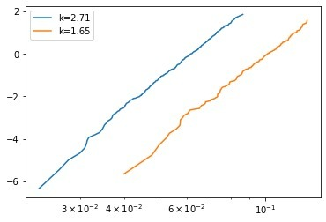
Kinetic Monte Carlos simulation
k_{B}
Bulk cell Intrinsic rate
200 devices per plot
50 x 50 x 5 (X Y Z) size grid

Slide 42


k_{I}
k_{B}
Interface cell Intrinsic rate
Bulk cell Intrinsic rate
k_{I} = n*k_{B}
Where n=1, 1.5, 2, 2.5, 3…
n=1.5
n=2
n=3
n=5.5
1100 devices per plot
50 x 50 x 5 (X Y Z) size grid

Slide 43
k_{I}
k_{B}
Interface cell Intrinsic rate
Bulk cell Intrinsic rate
k_{I} = n*k_{B}
Where n=1, 1.5, 2, 2.5, 3…
n=1.5
n=2
n=3
n=5.5
1100 devices per plot
50 x 50 x 5 (X Y Z) size grid

Slide 44
k_{I}
k_{B}
Interface cell Intrinsic rate
Bulk cell Intrinsic rate
Surface roughness modeling
k_{I} = n*k_{B}
Where n=1, 1.5, 2, 2.5, 3…
n=1.5
n=2
n=3
n=5.5
1100 devices per plot
50 x 50 x 5 (X Y Z) size grid

Slide 48
Issue 1
How best to define the increase in k due to neighboring defects?

Slide 49
Proposed Solution
k_{I}
Interface cell Intrinsic rate
k_{B}
Bulk cell Intrinsic rate

Slide 50
Proposed Solution
k_{I}+α₁
k_{I}+α₁
k_{B}+α₁
k_{B}+α₁
k_{B}+α₁
Defect
α_{count} = function(count of neighboring defects)
Where function is tbc:
Polynomial
Log
Power
Exponential
Look up table (from Yee Sin’s DFT)

Slide 51
Proposed Solution
k_{I}+α₂
k_{I}+α₂
k_{B}+α₂
k_{B}+α₂
Defect
k_{B}+α₁
k_{B}+α₁
k_{B}+α₁
α_{count} = function(count of neighboring defects)
Where function is tbc:
Polynomial [A*count^2+B*count+C]
Log [A*log(B*count+C)]
Power [A(count+C)^B]
Exponential [A*(exp(B*count+C))]
Look up table (from Yee Sin’s DFT)

Slide 52
Issue 2
How to account for the asymmetric pulsing of bipolar pulsing (BIP)?

Slide 53
Context
BIP pulsing is a repeated two step process.
Up (AP) → Down (P) → Up (AP) → Down (P) → …
Resistance for Up and Down are not the same. Ie. the k for defects are different.
BIP pulsing is a repeated two step process.
Up (AP) → Down (P) → Up (AP) → Down (P) → …
Resistance for Up and Down are not the same. Ie. the k for defects are different.

Slide 54
Proposed Solution
Process step no. = 1, 3, 5…
Process step no. = 2, 4, 6…
Bulk rate 1
Bulk rate 2
Interface rate 1
Interface rate 2

Slide 55
Proposed Solution
Process step no. = 1, 3, 5…
Process step no. = 2, 4, 6…
Bulk rate 1
Bulk rate 2
Interface rate 1
Interface rate 2

Slide 56
Problems
Physically inaccurate. BIP timestep is different from defect generation timestep. Ie. in one Up pulse, more than one defect can be generated.
Physically inaccurate. BIP timestep is different from defect generation timestep. Ie. in one Up pulse, more than one defect can be generated.

Slide 57
k_{I_Top}
Interface cell Intrinsic rate
k_{I} = n*k_{B}
Where n=1, 1.5, 2, 2.5, 3…
k_{I_bottom}
k_{B}
Bulk cell Intrinsic rate

Slide 58
Issue 3
How to model diffusion model?

Slide 59
Proposed Solution
Defect generation
k_{I}
k_{I}
k_{I}
k_{I}
k_{I}
k_{B}
k_{I}
k_{I}
k_{I}
k_{d}
k_{d}
k_{d}
k_{B}
k_{B}
k_{B}
k_{B}
k_{B}
k_{B}
k_{B}
k_{B}
k_{B}
k_{B}
k_{B}
k_{B}
k_{B}
k_{B}
k_{B}
k_{B}
k_{B}
k_{B}
k_{B}
k_{B}
k_{B}
k_{B}
k_{B}
k_{B}
k_{B}
k_{B}
k_{B}
k_{B}
k_{B}
k_{B}
0
0
0
0
0
0
0
0
0
0

Slide 60
Proposed Solution
Defect activation
k_{B}
k_{I}
k_{I}
k_{I}
k_{I}
k_{I}
k_{I}
k_{I}
k_{I}
k_{d}
k_{B}
k_{B}
k_{B}
k_{B}
k_{B}
k_{B}
k_{B}+α
k_{B}+α
k_{B}
k_{d}
k_{d}
k_{d}
k_{d}
k_{d}
k_{B}
k_{B}
k_{B}
k_{B}
k_{B}
k_{B}
k_{B}+α
k_{B}+α
k_{B}+α
k_{B}
k_{B}
k_{B}
k_{B}
k_{B}
k_{B}
k_{B}
k_{B}
k_{B}
k_{B}
k_{B}
0
0
0
0
0
0
0
0
0
0

Slide 61
Proposed Solution
Defect diffusion for unipolar
k_{B}
k_{I}
k_{I}
k_{I}
k_{I}
k_{I}
k_{I}
k_{I}
k_{I}
k_{I}
k_{B}
k_{B}+α
k_{B}+α
k_{B}
k_{B}
k_{B}+α
k_{B}+α
k_{B}+α
k_{B}
k_{d}
k_{d}
k_{d}
k_{d}
k_{d}
k_{B}
k_{B}
k_{B}
k_{B}
k_{B}
k_{B}
k_{B}+α
k_{B}+α
k_{B}
k_{d}
k_{d}
k_{d}
k_{d}
k_{d}
k_{B}
k_{B}
k_{B}
k_{B}
k_{B}
k_{B}
k_{B}+α
k_{B}+α
k_{B}+α
k_{B}
0
0
0
0
0
0
0
0
0
0

Slide 62
Proposed Solution
Defect diffusion for bipolar
k_{B}
k_{I}
k_{I}
k_{I}
k_{I}
k_{I}
k_{I}
k_{I}
k_{I}
k_{I}
k_{B}
k_{B}+α
k_{B}+α
k_{B}
k_{B}
k_{B}+α
k_{B}+α
k_{B}+α
k_{B}
k_{d}
k_{d}
k_{d}
k_{d}
k_{d}
k_{d}
k_{d}
k_{d}
k_{B}
k_{B}
k_{B}
k_{B}
k_{B}
k_{B}
k_{B}+α
k_{B}+α
k_{B}
k_{d}
k_{d}
k_{d}
k_{d}
k_{d}
k_{d}
k_{d}
k_{B}
k_{B}
k_{B}
k_{B}
k_{B}
k_{B}
k_{B}+α
k_{B}+α
k_{B}+α
k_{B}
0
0
0
0
0
0
0
0
0
0

Slide 63
Proposed Solution 1
Defect damage
k_{I}
k_{I}
k_{I}
k_{I}
k_{I}
k_{I}
k_{I}
k_{I}
k_{I}
k_{I}
k_{B}
k_{B}+α
k_{B}+α
k_{B}
k_{B}+α
k_{B}+α
k_{B}+α
k_{B}
k_{d}
k_{d}
k_{d}
k_{d}
k_{d}
k_{d}
k_{d}
k_{d}
k_{d}
k_{B}
k_{B}+α
k_{B}+α
k_{B}+α
k_{B}
k_{B}+α
k_{B}+α
k_{B}+α
k_{B}
k_{d}
k_{d}
k_{d}
k_{d}
k_{d}
k_{B}
k_{B}
k_{B}
k_{B}
k_{B}
k_{B}+α
k_{B}+α
k_{B}+α
k_{B}
k_{B}
0
0
0
0
0
0
0
0
0
0

Slide 64
Proposed Solution 2
Defect damage that results in a non-mobile defect (purple)
k_{I}
k_{I}
k_{I}
k_{I}
k_{I}
k_{I}
k_{I}
k_{I}
k_{I}
k_{I}
k_{B}
k_{B}+α
k_{B}+α
k_{B}
k_{B}+α
k_{B}+α
k_{B}+α
k_{B}
k_{d}
k_{d}
k_{d}
k_{d}
k_{d}
k_{d}
k_{d}
k_{d}
k_{d}
k_{B}
k_{B}+α
k_{B}+α
k_{B}+α
k_{B}
k_{B}+α
k_{B}+α
k_{B}+α
k_{B}
k_{B}
k_{B}
k_{B}
k_{B}
k_{B}
k_{B}+α
k_{B}+α
k_{B}+α
k_{B}
k_{B}
0
0
0
0
0
0
0
0
0
0

Slide 65
Proposed Solution
Defect termination
k_{I}
k_{I}
k_{I}
k_{I}
k_{I}
k_{I}
k_{I}
k_{I}
k_{I}
k_{I}
k_{B}
k_{B}
k_{B}
k_{B}
k_{B}
k_{B}
k_{B}
k_{B}
k_{B}
k_{B}
k_{B}
k_{B}+α
k_{B}+α
k_{B}+α
k_{B}
k_{B}
k_{B}
k_{B}
k_{B}
k_{B}
k_{B}
k_{B}+α
k_{B}+α
k_{B}
k_{B}
k_{B}
k_{B}
k_{B}
k_{B}
k_{d}
k_{d}
k_{d}
k_{d}
k_{d}
0
0
0
0
0
0
0
0
0
0

Slide 66
Proposed Solution
Asymmetry
k_{I}
k_{I}
k_{I}
k_{I}
k_{I}
0
0
0
0
0
Interface
rate 1
k_{I}
k_{I}
Interface
rate 2
k_{B}
k_{B}+α
k_{B}+α
k_{B}+α
k_{B}
k_{B}
k_{B}+α
k_{B}+α
k_{B}+α
k_{B}
k_{d}
k_{B}
k_{B}
k_{d}
k_{d}
Bulk rate 1
Bulk rate 2
k_{B}
k_{B}+α
k_{d}
k_{d}
k_{B}+α
k_{B}
k_{B}
k_{B}+α
k_{d}
k_{B}+α
k_{B}
k_{d}
k_{d}
k_{d}
k_{B}+α
k_{B}+α
k_{B}
k_{B}+α
k_{d}
k_{B}+α
k_{B}+α
k_{B}
k_{B}
k_{B}+α
k_{B}+α
k_{B}+α
k_{B}
α 1
α 2
k_{d}
k_{d}
0
0
0
0
0
k_{I}
k_{I}
k_{I}
k_{I}
k_{I}
Diffusion
rate 1
Diffusion
rate 2

Slide 67
DFT simulation for LUT
2D illustration
1
2
3
Format:
Ef = Dictionary{Positions: Ef_{positions}}
Example:
Ef = Dictionary{0: Ef₀;
1: Ef₁; 2: Ef₂; 3: Ef₃; …
1,2: Ef_{1,2}; 1,3: Ef_{1,3}; 1,4: Ef_{1,4}; …
1,2,3: Ef_{1,2,3}; 1,2,4: Ef_{1,2,4}; …
…
1,2,3,4,5,6,7,8: Ef_{1,2,3,4,5,6,7,8}}
4
Ef
5
6
7
8

Slide 68
Possible Model BIP
How does E-field or Current worsen Induced Neighbor or Diffusion/Drift?
BIP is Arrhenius. Ie. Higher temp accelerates single process. Dominant single process.
Induced Neighbor and Diffusion are working together model below
Missing: explanation for the kink in H vs V
Initial state has some defects
Are most of the initial defects at the interface?
Do most of the defects form at the interface?
Induced
Neighbor
Diffusion/Drift
*Would there a shielding effect?
Diffusion/Drift
Gap to Top Electrode
Induced
Neighbor
Combined gap is smaller than UNI
→Shorter TTF
Gap to Btm Electrode

Slide 69
Possible Model UNI
How does E-field or Current worsen Induced Neighbor or Diffusion/Drift?
UNI is non-Arrhenius. Ie. Higher temp accelerates multiple processes. No dominant single process.
Induced Neighbor and Diffusion are working against each other in model below
UNI MTTF approaches BIP MTTF at higher temp.
Main difference in UNI+ and UNI- is SH.
Initial state has some defects
Are most of the initial defects at the interface?
Do most of the defects form at the interface?
Induced
Neighbor
Diffusion/Drift
*Would there a shielding effect?
Diffusion/Drift
Induced
Neighbor
Gap to Top Electrode
Gap is larger than BIP
→ Longer TTF
Might be harder for defects to diffuse at the interface due to lattice mismatch

Slide 70

We model the O defects as BCC about a reference Oxygen atom
Model
https://msestudent.com/what-is-the-difference-between-fcc-and-bcc-crystal-structure-properties-interstitial-sites-and-examples/
: O atom

Slide 71
Defect interaction LUT
N = 1 defect
: defect
: reference O atom
Subtotal
Case 1
Total
Case 1

Slide 72
Defect interaction LUT
N = 2 defects
Subtotal
Case 1
Case 2
Case 3
Total
Case 2
Case 3
Case 4

Slide 73
Defect interaction LUT
N = 3 defects
Subtotal
Case 1
Case 2
Case 3
Case 4
Total
Case 5
Case 6
Case 7
Case 8

Slide 74
Defect interaction LUT
N = 4 defects
Subtotal
Case 1
Case 2
Case 3
Case 4
Total
Case 9
Case 10
Case 11
Case 12
Subtotal
Case 5
Case 6
Case 7
Case 8
Total
Case 13
Case 14
Case 15
Case 16

Slide 75
Defect interaction LUT
N = 5 defects
Subtotal
Case 1
Case 2
Case 3
Case 4
Total
Case 17
Case 20
Case 18
Case 19

Slide 76
Defect interaction LUT
N = 6 defects
Subtotal
Case 1
Case 2
Case 3
Total
Case 21
Case 22
Case 23

Slide 77
Defect interaction LUT
N = 7 defect
: defect
: reference O atom
Subtotal
Case 1
Total
Case 24

Slide 78
Defect interaction LUT
N = 7 defect
: defect
: reference O atom
Subtotal
Case 1
Total
Case 25

